Slide 1

Bank Customer Loan Prediction
Data mining final project
Students:
1. Ngô Anh Tuấn
2. Nguyễn Mạnh Cường
3. Hoàng Thái Sơn
Teacher: Đoàn Nhật Quang
December 09, 2024

Slide 2

Agenda
Problem and Motivation Statement
Project process
Data Analysis
Modeling Approach
Experiments
Evaluation and discussion

Slide 3

Problem
Predicting customers' loan borrowing capability is a crucial task for banks and financial institutions. ​
Problems encountered when classifying customer loan capability:
Increased risk of bad debt due to incorrect assessment of repayment ability
Waste of marketing resources when targeting wrong customers
Impact on bank's reputation and brand
Increased debt management and processing costs

Slide 4

Motivation
Benefits achieved when solving the problem: ​
Increase lending efficiency
Improve customer service capabilities
Reduce risks during lending process
Enhance risk management capabilities
This Photo by Unknown Author is licensed under CC BY-SA

Slide 5

Project process

Slide 6

Collect data
Dataset https://www.kaggle.com/datasets/krantiswalke/bank-personal-loan-modelling
Data structure
1. ID : Customer ID
2. Age : Customer's age in completed years
3. Experience : Years of professional experience
4. Income : Annual income of the customer ($000)
5. ZIP Code : Home Address ZIP code.
6. Family : Family size of the customer
7. CCAvg : Avg. spending on credit cards per month ($000)
8. Education : Education Level. “1”: Undergrad; “2”: Graduate; “3”: Advanced/Professional
9. Mortgage : Value of house mortgage if any. ($000)
10. Personal Loan : Did this customer accept the personal loan offered in the last campaign?
11. Securities Account : Does the customer have a securities account with the bank?
12. CD Account : Does the customer have a certificate of deposit (CD) account with the bank?
13. Online : Does the customer use internet banking facilities?
14. Credit card : Does the customer use a credit card issued by

Slide 7
System prepare
Using Google Colab to develop system
Language for programming: python
Library for data mining
NumPy: Used for computation and matrix processing
Pyplot, Seaborn: Used for data visualization such as boxplot, scatter, histogram
Scikit-learn: Used to build models such as KNN, Random Forest, Decision Tree...

Slide 8
Data Analysis

Slide 9
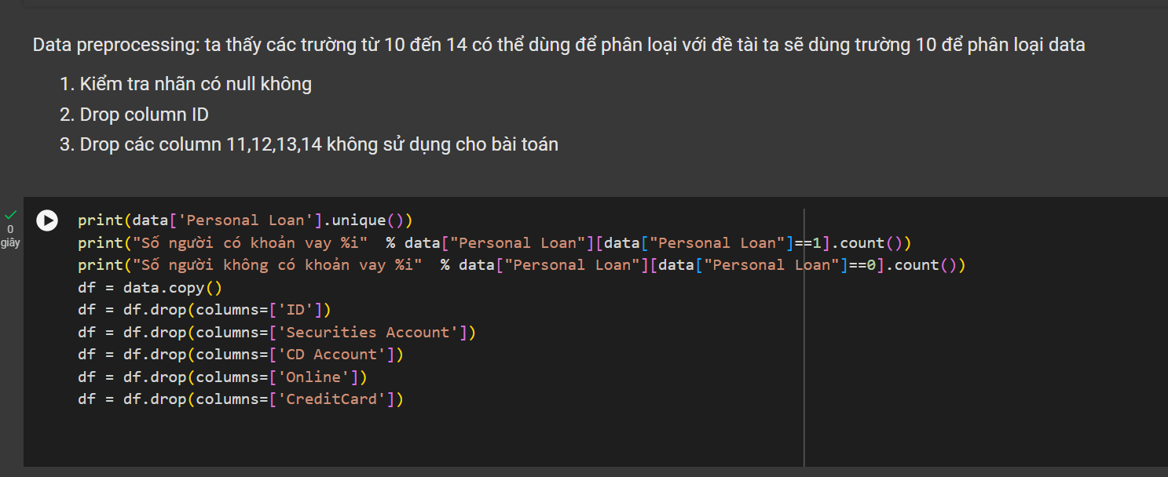
Data preprocessing
Target label column “Personal Loan”
Check null
Drop others label column

Slide 10
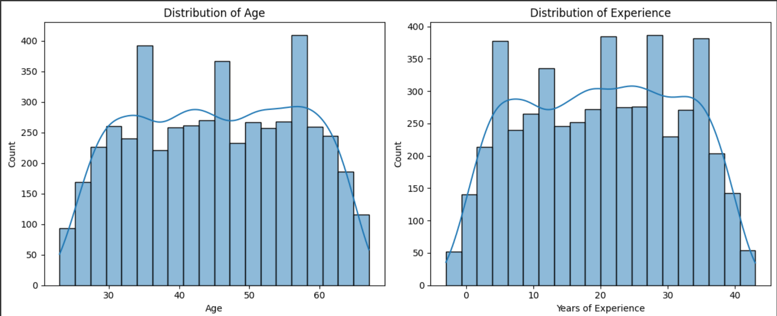
Visualization Data

Slide 11
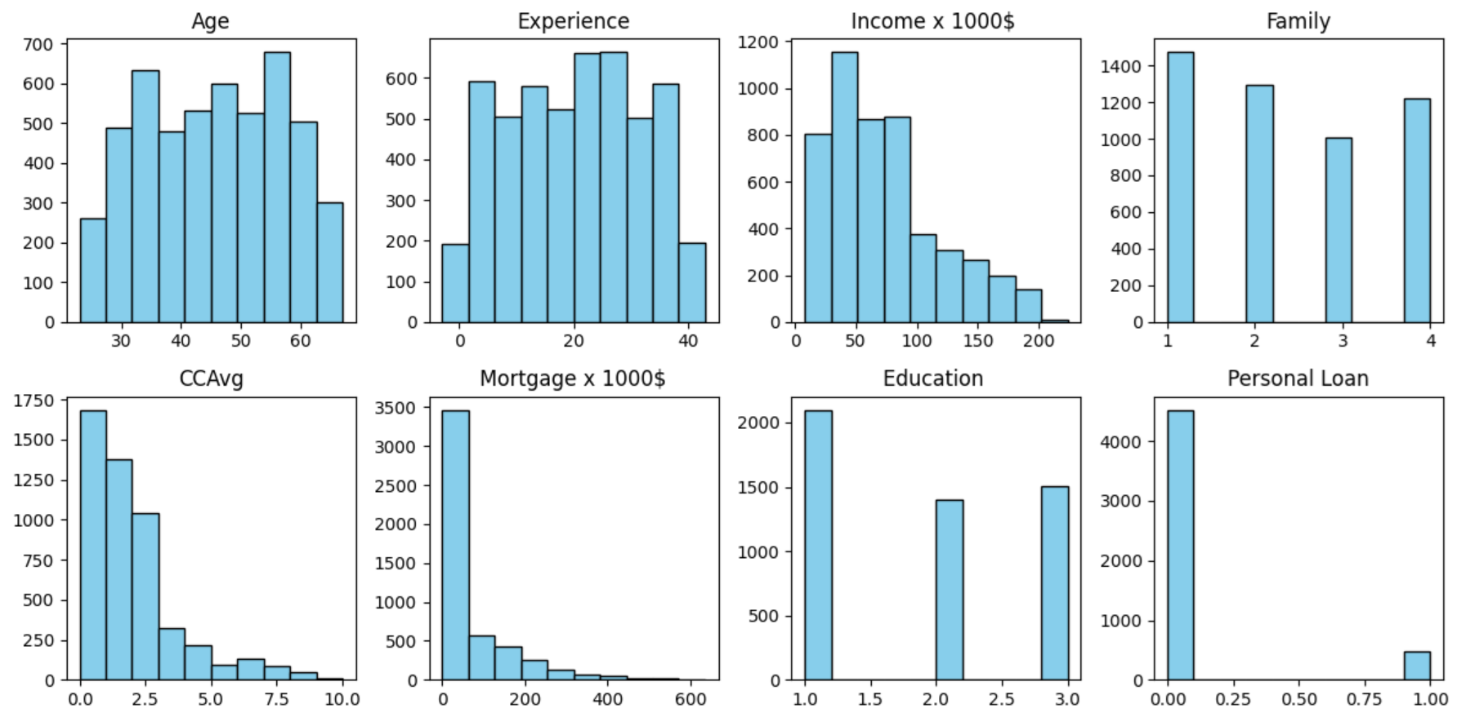
Visualization Data

Slide 12
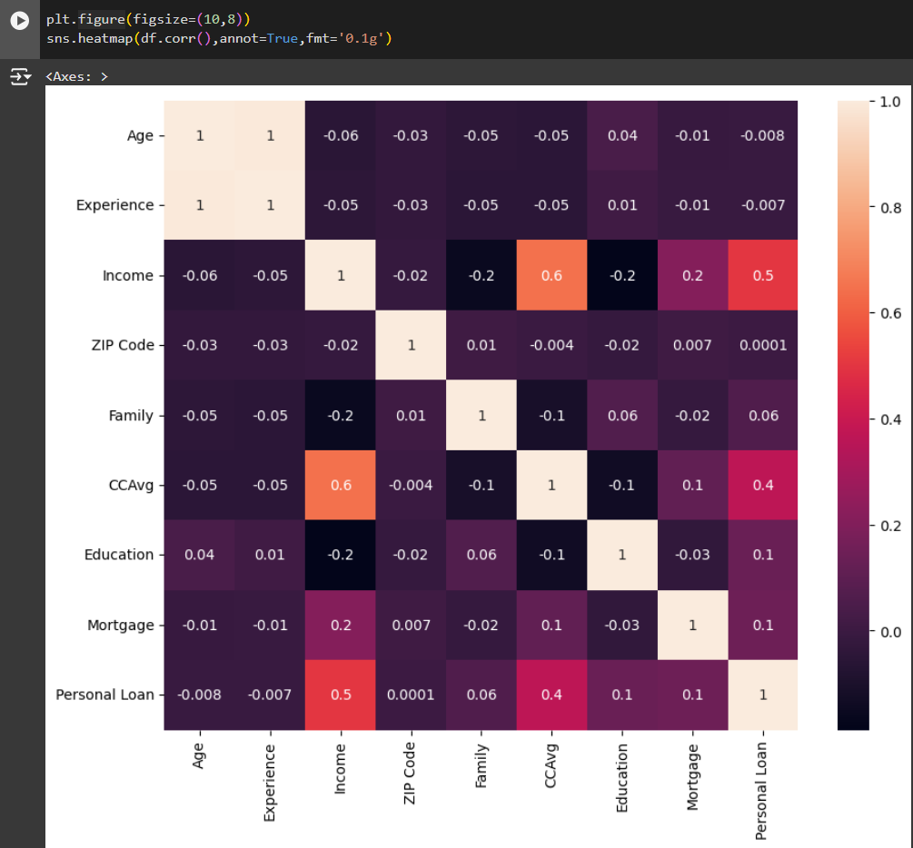
Data analysis
Correlation matrix between data fields
Fields ‘Age' and ‘Experience' have similar correlation values so we will remove them from the classification

Slide 13
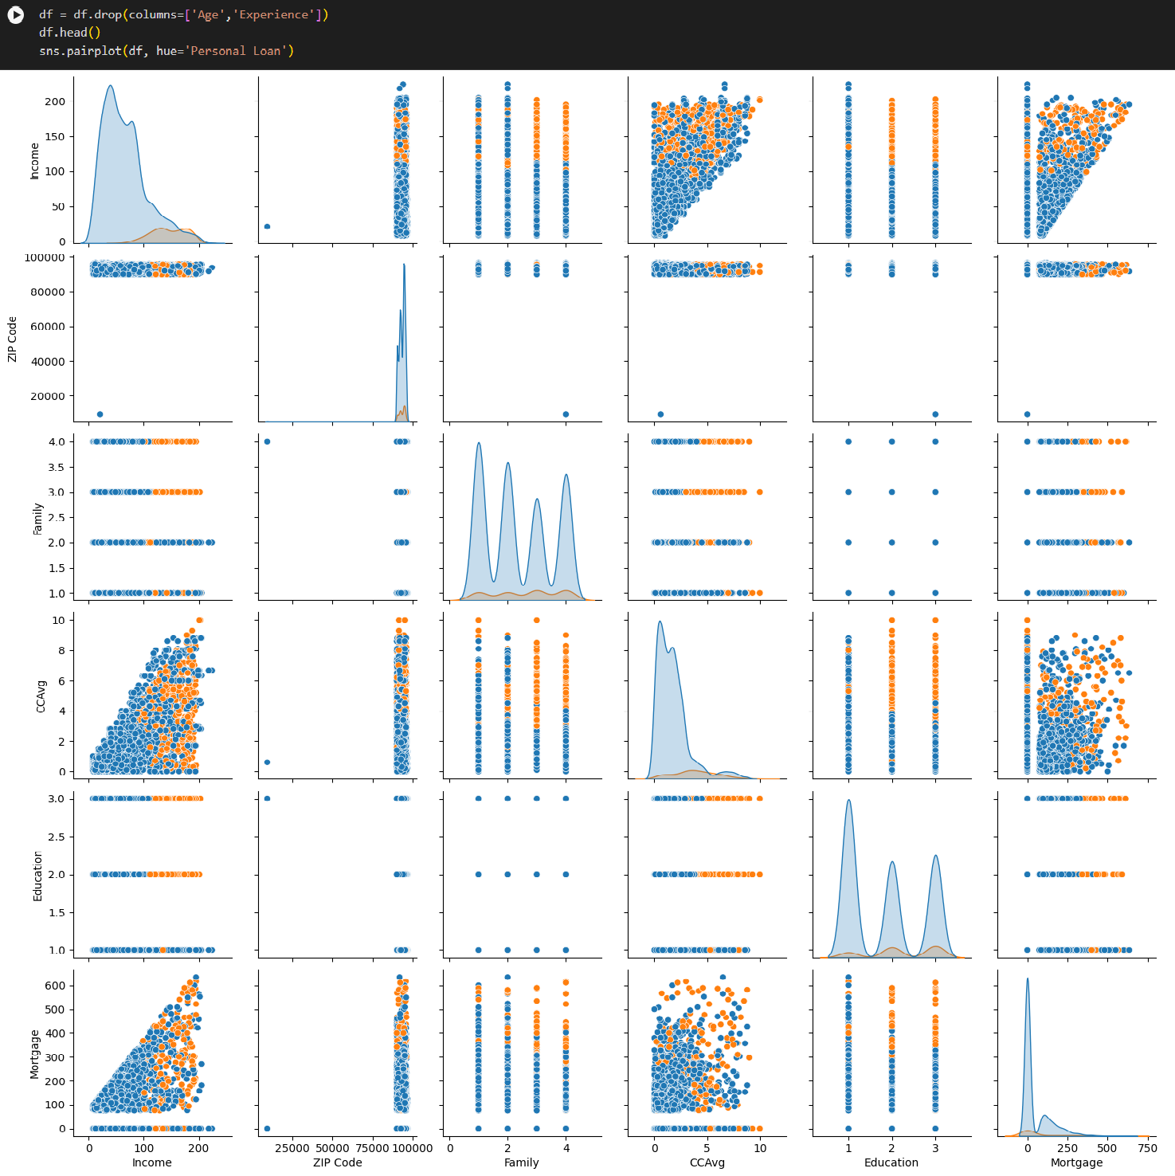
Data analysis
Drop columns Age and Experience, Scatter graph of data

Slide 14
Modeling Approach

Slide 15
Implementation Steps
Split data into train/test sets
Scale data
Train model with cross-validation
Evaluate model using metrics :
Accuracy
Precision, Recall
F1-score
ROC curve & AUC
Tune hyperparameters
Compare results between models

Slide 16
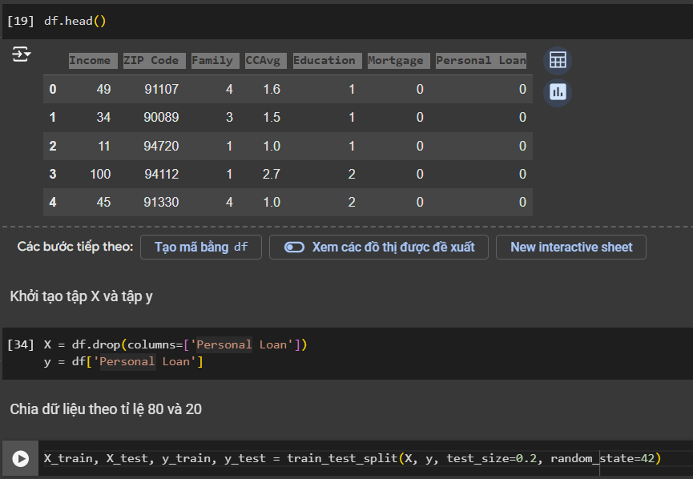
Data Initialization
Data after preprocessing
Initialize X set and y set
Split data

Slide 17

Logistic Regression Model

Slide 18
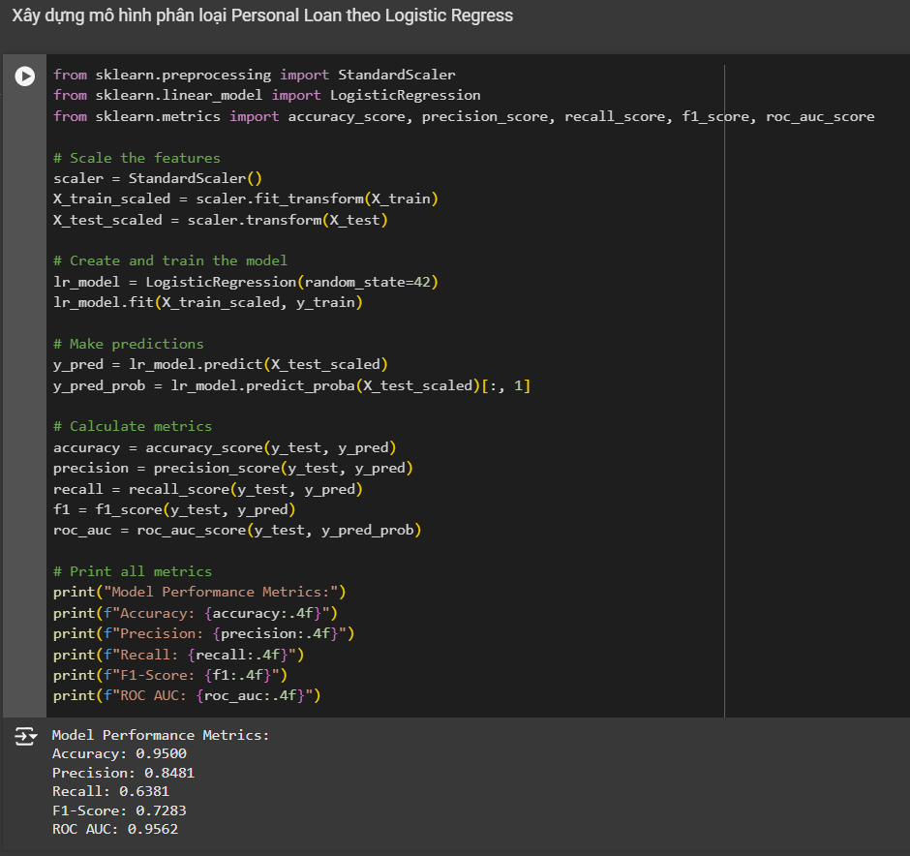
Logistic Regression Model
Scale data
Initialize X trained dataset and X test dataset

Slide 19
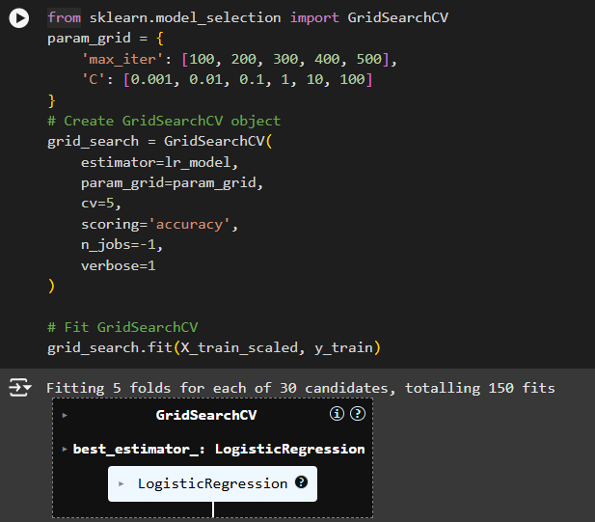
Tunning LR hyper params
Use GridSearchCV for tunner

Slide 20
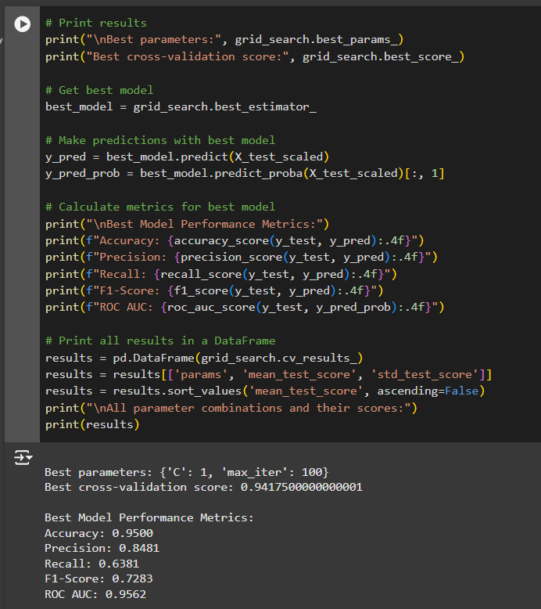
Best Logistic Regression model
Model Metrics
Accuracy
Precision
Recall
F1-score
Roc Auc

Slide 21
KNN Model

Slide 22
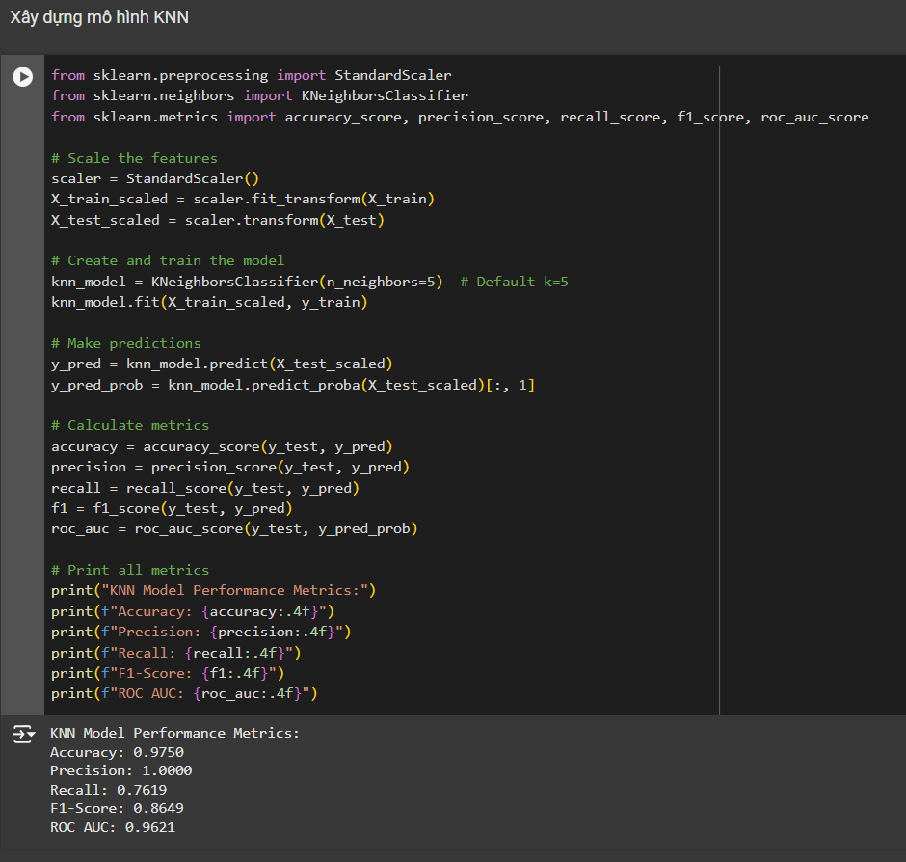
KNN Model
Scale data
Metrics

Slide 23
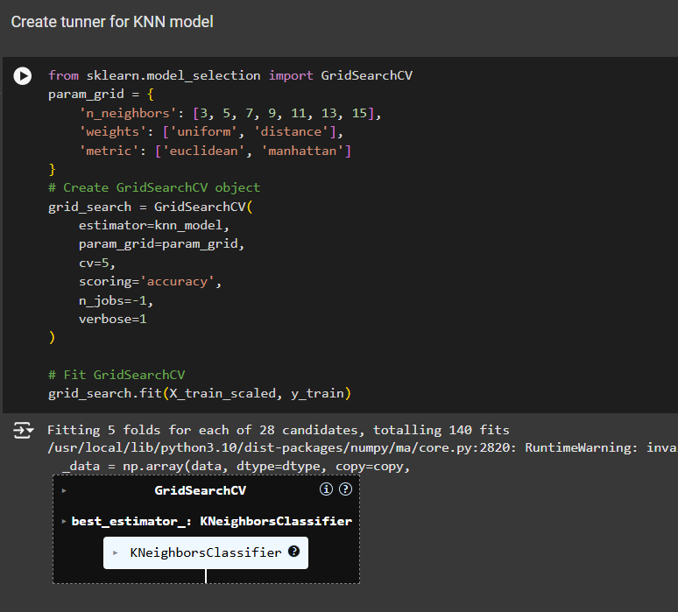
Tunning KNN hyper params
Initialization KNN tunner

Slide 24
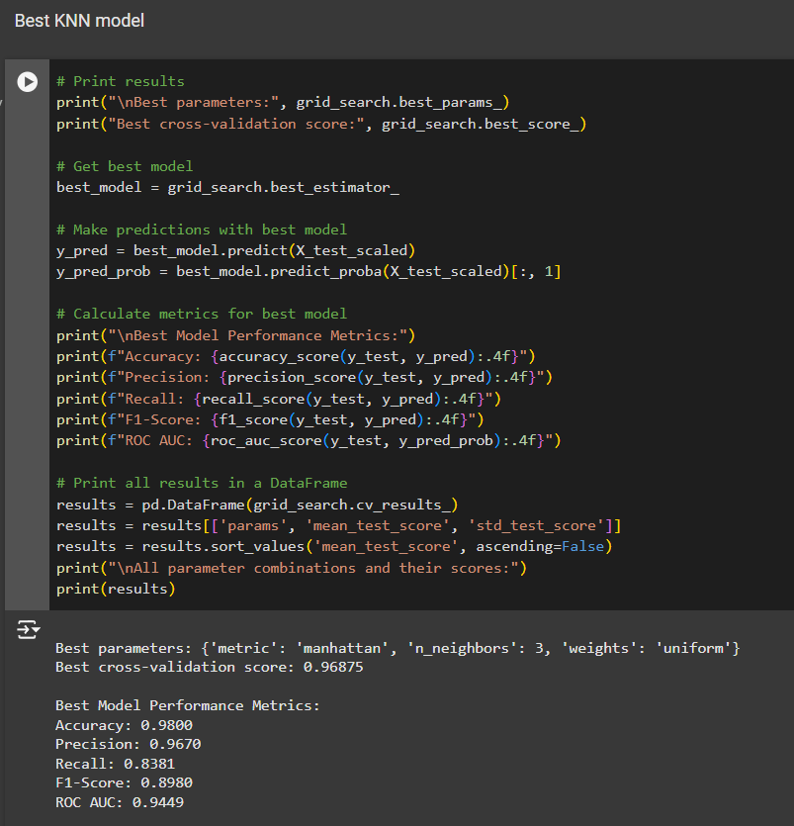
Best KNN model
Model Metrics
Accuracy
Precision
Recall
F1-score
Roc Auc

Slide 25
Comparison Results
LR
KNN
Best metrics
Accuracy: 0.9500
Precision: 0.8481
Recall: 0.6381
F1-Score: 0.7283
ROC AUC: 0.9562
Best metrics
Accuracy: 0.9800
Precision: 0.9670
Recall: 0.8381
F1-Score: 0.8980
ROC AUC: 0.9449

Slide 26
DISCUSSION

Slide 27


Team Members
Ngô Anh Tuấn
Nguyễn Mạnh Cường
Hoàng Thái Sơn
Member
Member
Member

Slide 28

Thanks
We look forward to working together.
Contact
<Ngô Anh Tuấn>ngo.tuan12@gmail.com

